Slide 1

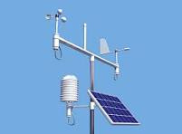
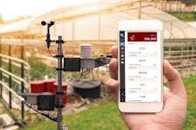
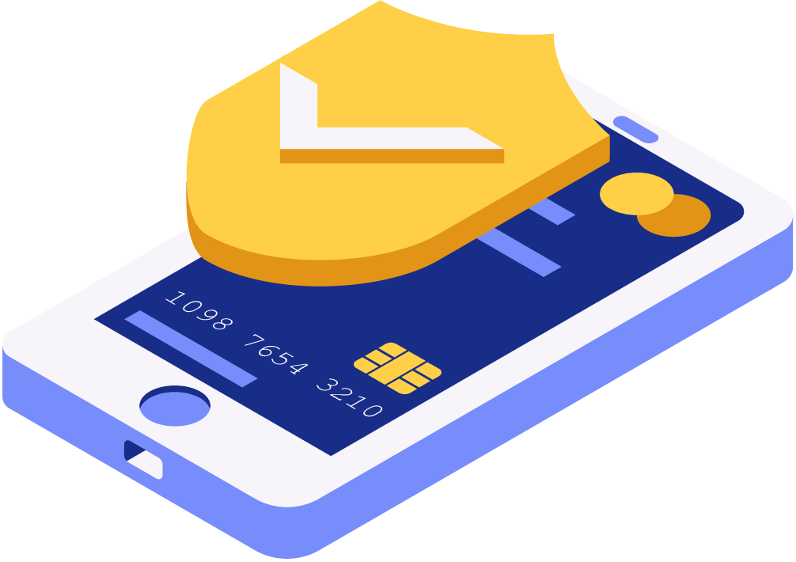

WHETHER
01/18
MONITORING SYSTEM

Slide 2
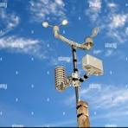
WHAT IS A WEATHER MONITORING
SYSTEM?
02/18
This project is an IoT-based weather monitoring system that measures temperature,humidity,pressure,altitude,and rain drops using 3 important sensors DHT11 sensor,BMP180 sensor,and RainDrop sensor and sends the collected data to the microcontroller that is called NodeMcu Esp8266 that makes a local proccess then it sends the data through a wifi connection to the thingspeak The readings are displayed online in real time database using ThingSpeak.

Slide 3

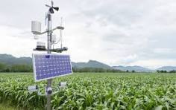
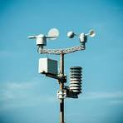
PROBLEM
STATEMENT
03/18
People are usually depend on whether apps that is:
Not always accurate in small places like farms and indoor at homes and there is no real-time updates also it cannot be accessed remotely

Slide 4

04/18
An IoT-based weather monitoring system that:
Collects data automatically
Sends readings to the cloud
Shows real-time graphs online
Works remotely from anywhere
Accurate at results in small places
PROPOSED
SOLUTION

Slide 5
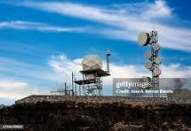
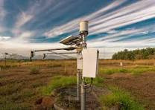

WHY OUR SOLUTION WORKS
05/18
Uses WiFi-integrated microcontroller (NodeMCU)
Cloud platform that automatically stores data
Sensors readings update every few seconds
User can access data anytime, anywhere

Slide 6
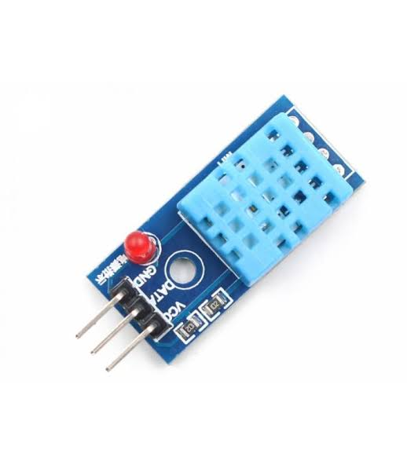
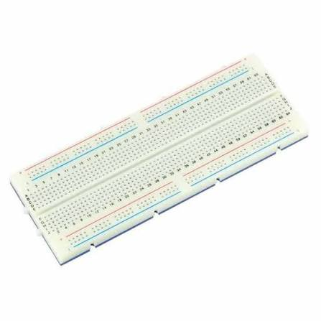
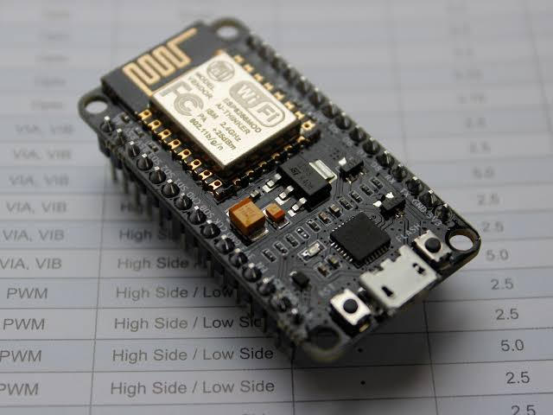

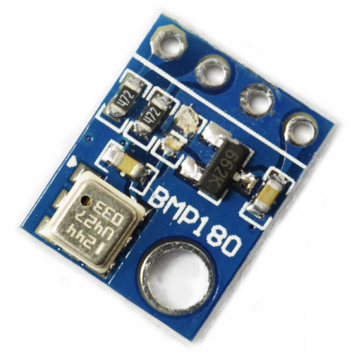
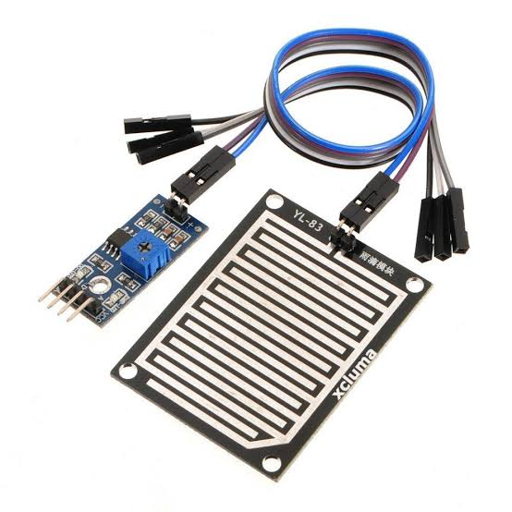
HARDWARE COMPONENTS
06/18
DHT 11 Sensor
BreadBoard
It’s a very important sensor that reads tempreture and humidity and also can calculate heat index using both tempreture and humidity
A Board that we used for assimbling our project and connect it with each other
Node Mcu ESP8266
It’s the brain of our project because it controlles every thing it’s a low cost ,wifi integreated microcontroller
BMP 180 Sensor
Rain Drop module and water sensor
A Barometric Pressure and Altitude Sensor that is very helpful in our project
A very helpful sensor that is been able to tell us whether there is rain or not

Slide 7

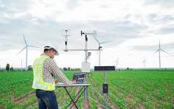
SOFTWARE USED
07/18
Arduino IDE — for coding and uploading the program
ThingSpeak Cloud Platform — for storing and visualizing data

Slide 8
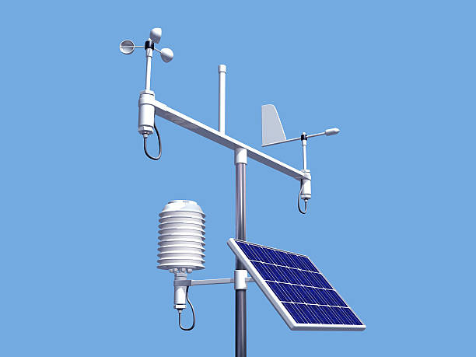
08/18
HOW THE SYSTEM WORKS
The Four Sensors read the signals from the environment and Sends it to the microcontroller the esp8266 proccesses the collected data before sending it to the cloud through a wifi connection
After that the data get proccessed and visualised
On the thingspeak

Slide 9
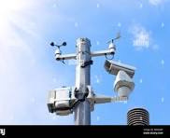
09/18
PROJECT
This system can be used for:
Home environment monitoring
Smart agriculture
Weather stations
School & university comfort monitoring
Smart city applications
USAGE

Slide 10


ADVANTAGES OF THE PROJECT
10/18
low-cost
Accurate results
Real-time monitoring
Works remotely
Cloud data storage and visualization
Scalable for more sensors

Slide 11
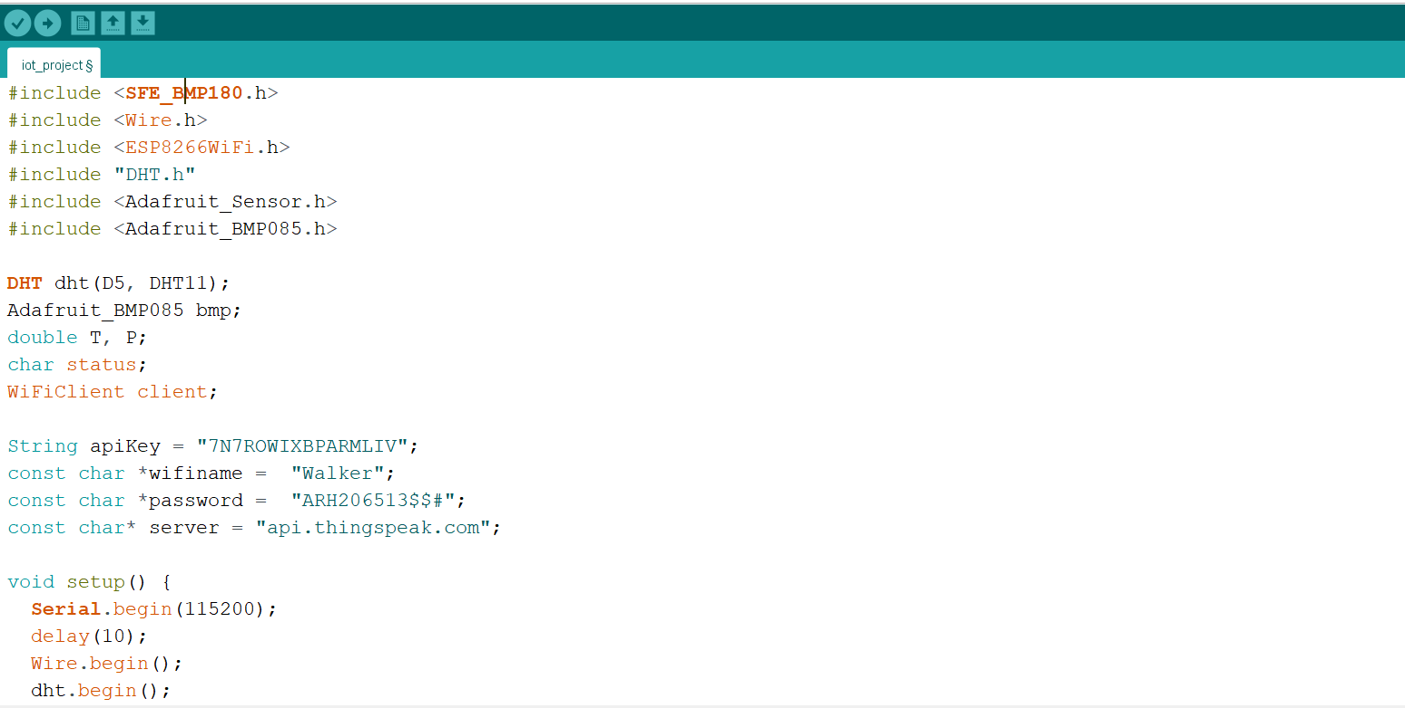
THE PROJECT CODE
11/18

Slide 12
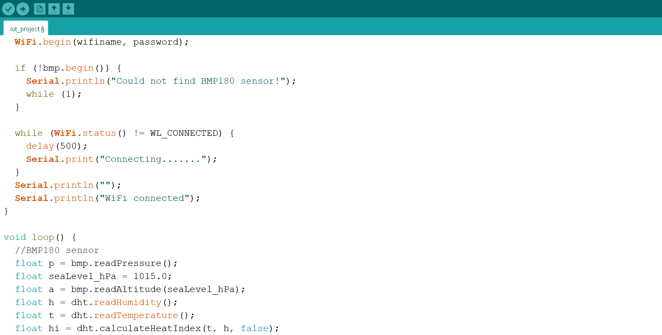
THE PROJECT CODE
12/18

Slide 13
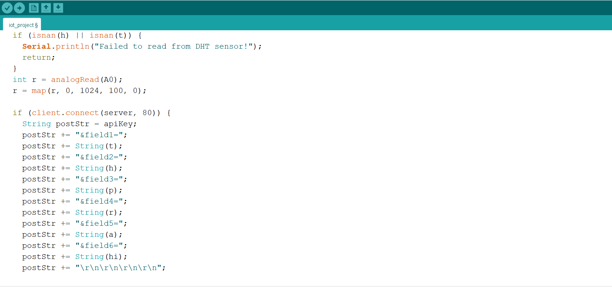
THE PROJECT CODE
13/18

Slide 14
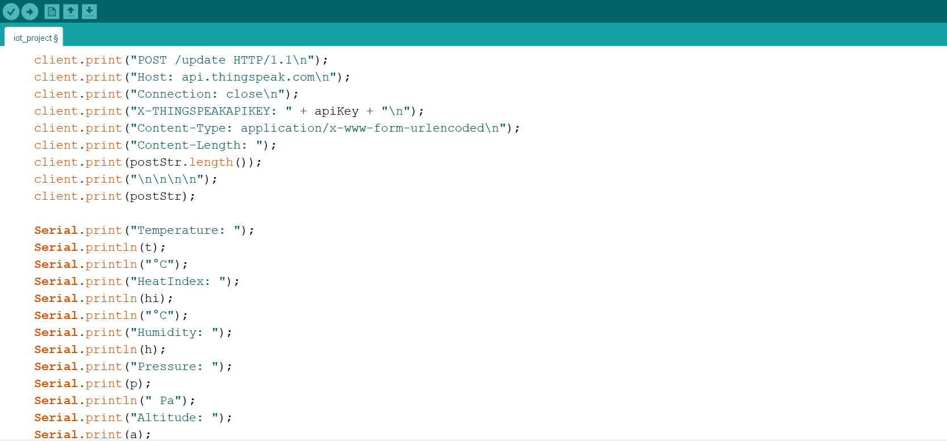
THE PROJECT CODE
14/17

Slide 15
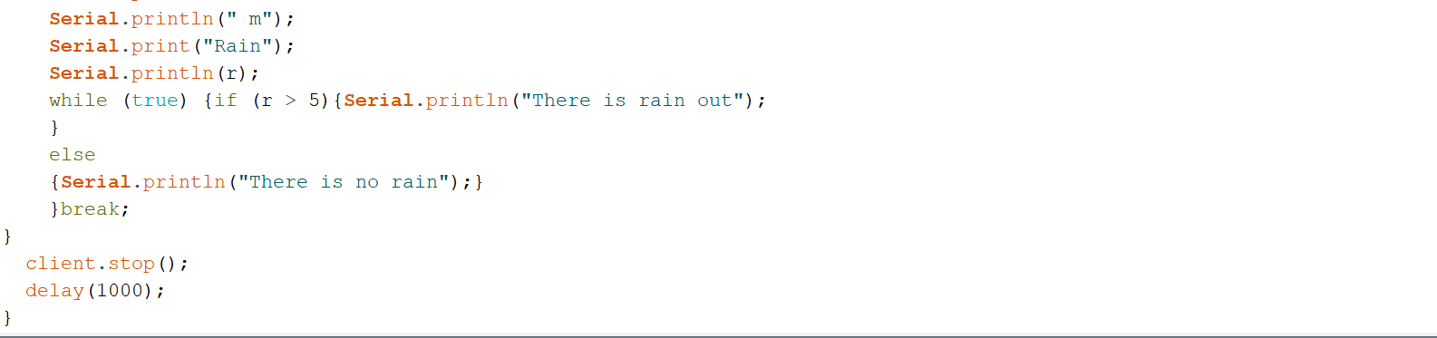
THE PROJECT CODE
15/18

Slide 16
FUTURE VISION OF THE PROJECT
16/18
In the future, the system can be improved by:
Adding more sensors
Building a mobile app for notification alerts
Using solar power
Adding machine learning for weather prediction

Slide 17
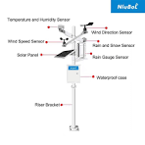
17/18
The project successfully creates a functional IoT weather monitoring system that:
Measures temperature , humidity and more
Sends data automatically to the cloud
Displays readings in real-time graphs
FINAL
RESULT
Whether Monitoring Project

Slide 18
18/18
Shahab Ragab Hassan(IT 1) (TL)
Mahmoud Reda Zahra (iT 1)
Marwan Mohamed Ahmed(IT 2)
Mina Atef Sami(IT 2)
Hassan Walid Hassan(IT 1)
Mahmoud Mohamed Abd Alhakam(IT 2)
THANK
YOU!

